Slide 1
Fall prevention and recovery
W. Julia Masulis, PT, DPT, NCS
Email me if you have any questions: Wingsheung.masulis@huntingtonhospital.com

Slide 2
Objectives
Learn about fall risks
Learn how to prevent these risks
Learn how to fall safely
Learn what to do when a fall has occurred
Learn few exercises and tips

Slide 3
Facts
Falls can be devastating
1 out of 10 falls causes serious injuries such as head injury or hip fractures
Recovery physically and emotionally can be lengthy
Some may never return to living independently
Falls can be deadly
It is the leading cause of fatal injuries in older adults
Each year, at least 25,000 older adults died of falls
Rates of fall-related death is rising over the decades

Slide 5
Why is fall prevention important?
Falls are preventable.

Slide 6
Fall risk factor
A fall risk factor is something that increases a person’s chances of falling
Although risk factors increase with age, aging is not an inevitable cause
There are 3 main factors and they interact with one another
Biological
Behavioral
Environmental

Slide 7
1st factor: Biological
Muscle weakness or balance problems
Medication side effects and/or drug interactions
Polypharmacy = >5 medications
Chronic health conditions
Examples: arthritis, stroke, diabetes, Parkinson’s Disease, dementia
Vision changes and vision loss
Loss of sensation in feet
Peripheral neuropathy

Slide 8
2nd factor: Behavioral
Alcohol use
Risky behaviors
standing on a chair in place of a step stool
Multi-tasking
Inactivity

Slide 9
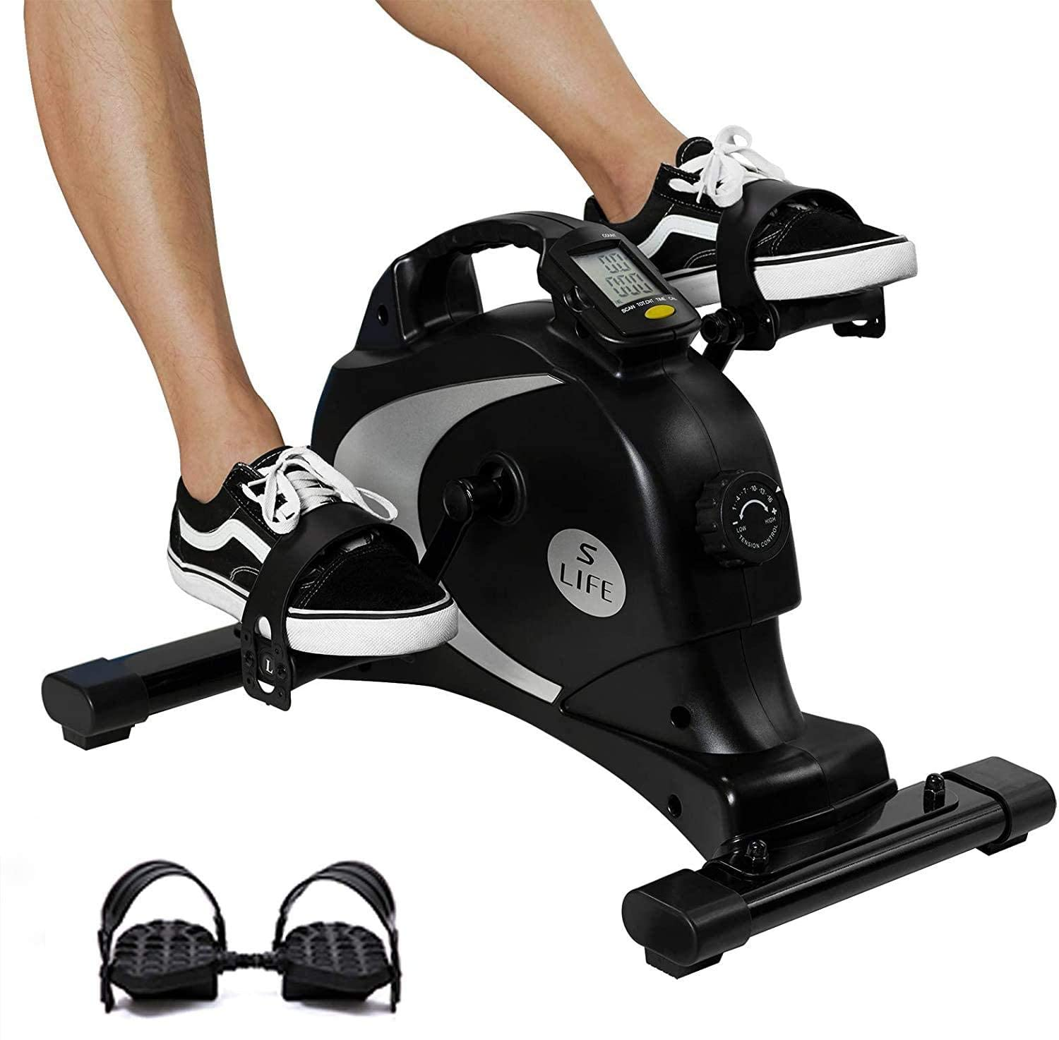
Stay Active!
Strength training
Flexibility training
Balance training
Tai Chi, yoga
Aerobic training
Endurance! Also good for the lungs and heart
Aquatic classes
Cognition training
Train your brain for reaction time, problem solving skills
If all fails, at least stick with a 10-minute walking program daily.
Look for exercise class offered in gym, local senior centers

Slide 10
Let’s do an activity – Timed Up and Go Test
Start: sit back in chair w/ armrests
May use assistive devices, armrests
Time how long it takes to
Stand from chair
Walk 10 feet forward
Turn around to sit back in chair
Score ≥13.5 seconds means higher risk of fall for community-dwelling adults
Notes:
Shumway-cook et al. 2000

Slide 11
Proper sit to stand technique
Scoot buttocks to front half of chair
Place feet apart and behind knees
Lean head and body forward
Shoulders over knees
Push yourself to stand by straightening your legs and back

Slide 12
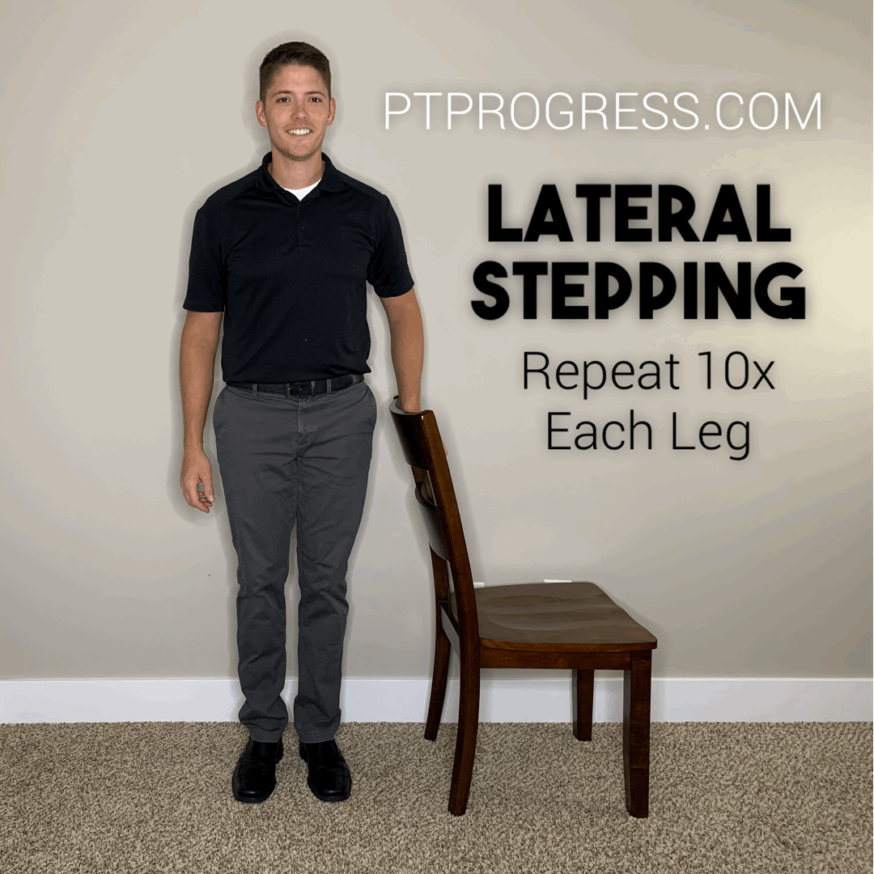
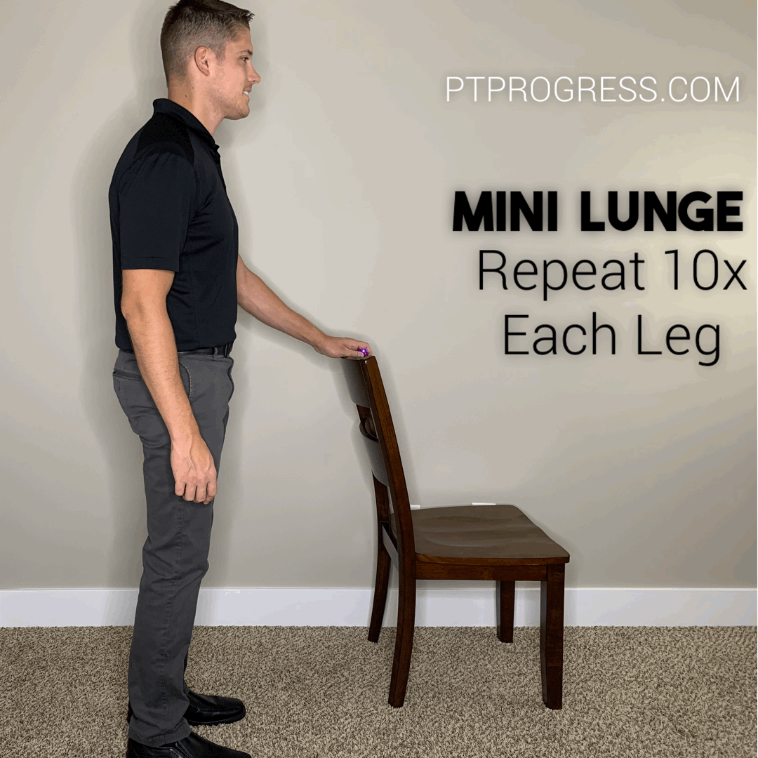
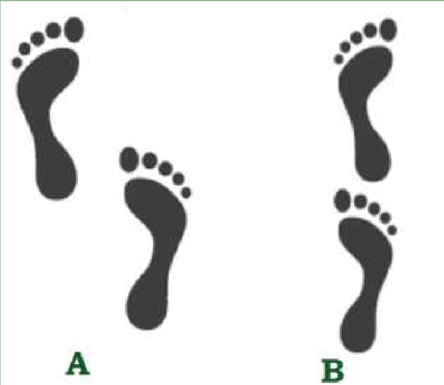
Highly recommended exercises
With hands supported on back of chair or counter:
Mini squats or sit to stand
3-way hip kicks
Kick leg forward, side, back
Mini forward lunge
Side step
Balance with narrow stance
Notes:
https://www.ptprogress.com/balance-exercises-for-seniors/

Slide 13
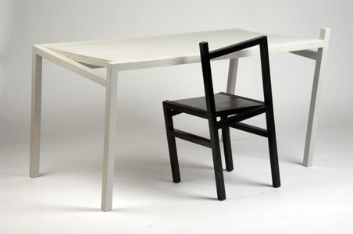
3rd factor: Environmental
Throw rugs
Clutter
Broken, uneven, tall, and/or too many steps
Poor lighting (too dim or too bright)
Pets
Unstable furniture
Extension cords
Low toilet seats
Slopping driveway
Cracks in sidewalk
Lack of or poorly secured grab bars, wet surfaces, young children
Notes:
https://healthcareassociates.net/top-10-tripping-hazards-for-older-adults/
Let there be light

Slide 15
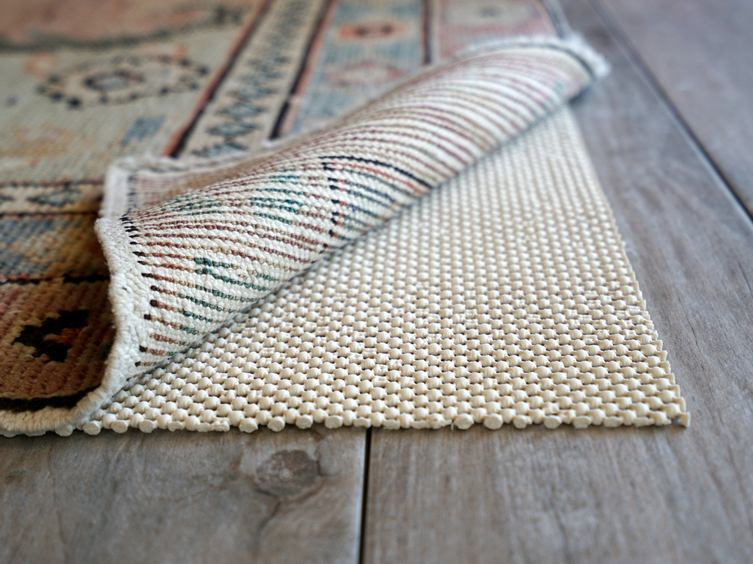
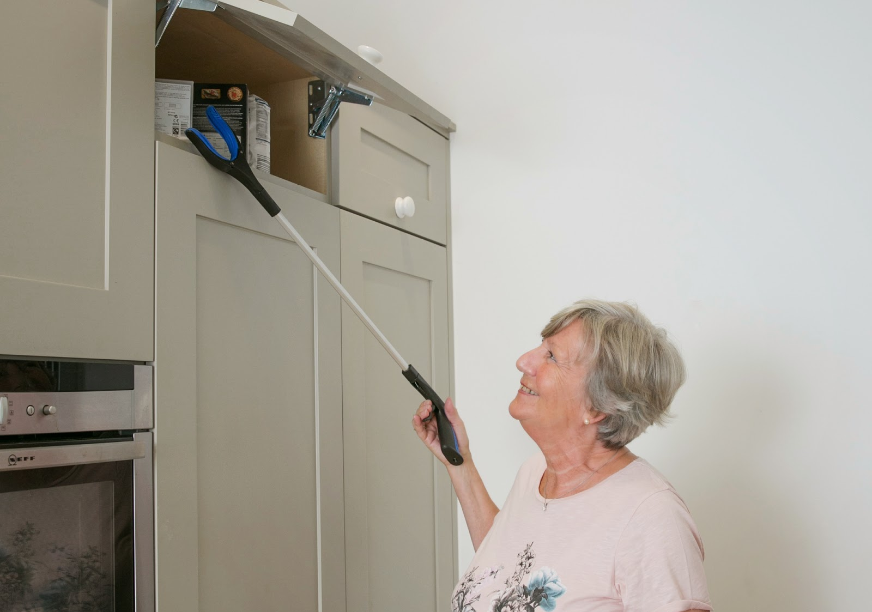
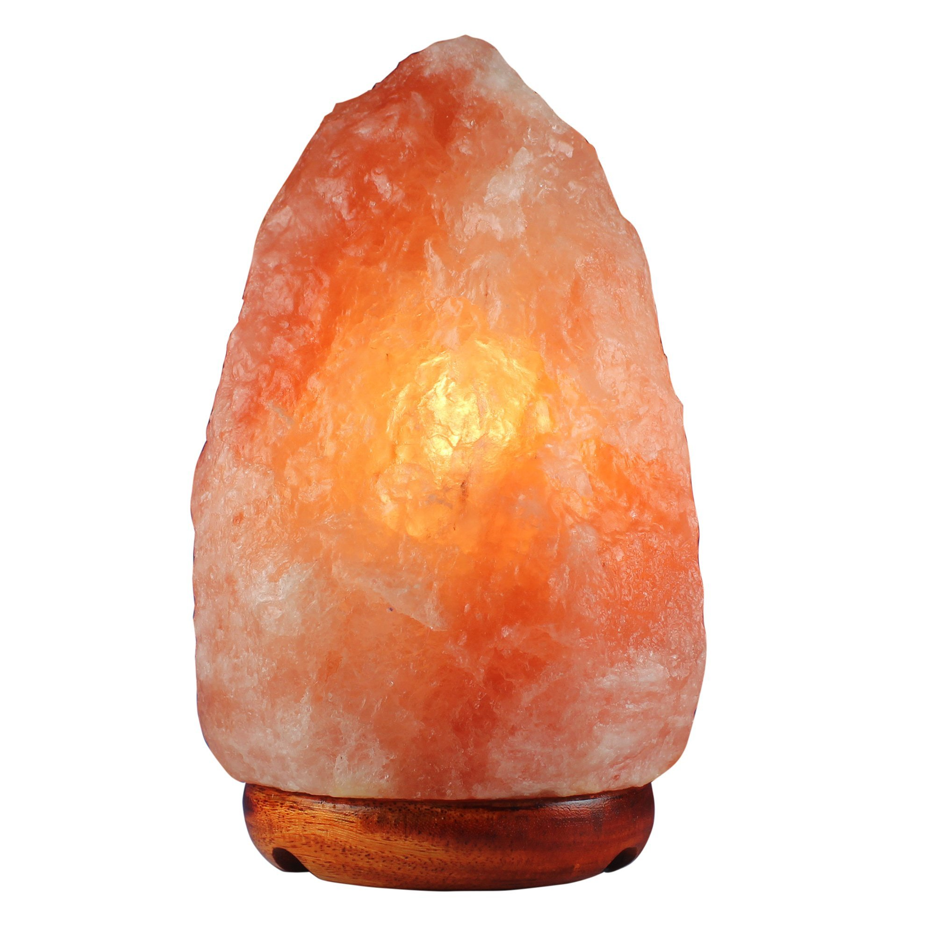
Fall proofing
Non-skid mats or strip on surfaces that can get wet
Remove throw rugs/kitchen mats or secure with non-slip strips
Arrange furniture out of walking paths (ex: low coffee table)
Make sure chairs and couches are stable and at good height for you to get in/out
Fasten handrail and grab bars
Place electric cords against wall
Put commonly-used items at reachable and easily accessible area
Otherwise, have a reacher/grabber tool (long thongs?)
Nightlight or flashlight for nighttime
Notes:
https://www.nia.nih.gov/health/fall-proofing-your-home

Slide 16
Fall-proof Yourself
Footwear
Correct medication
Timing, dosage, expiration date
Roadmap/visual imagery
Know where you are going
Proper meals
Blood sugar
Proper hydration
Proper assistive device
AFO, cane, walker, corrective lens
Notes:
(Flip-flop… “flappity flop you go”)

Slide 17
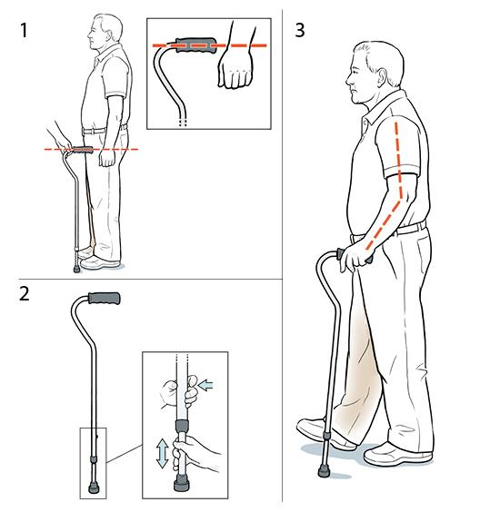
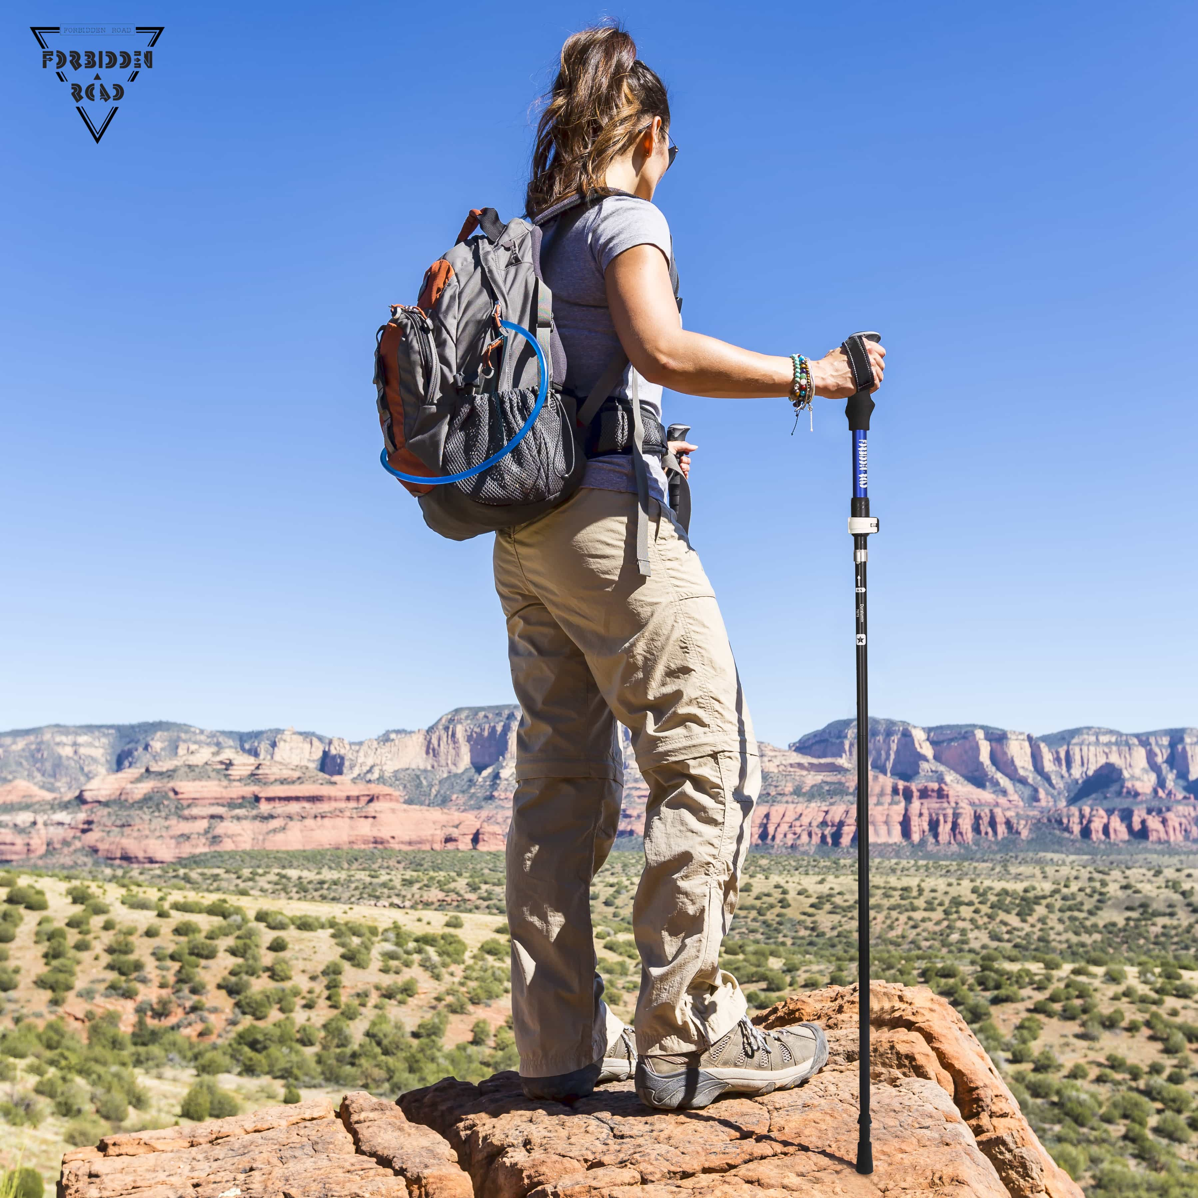
Let’s talk about canes not the ones made of peppermint
J.M. rule of thumb: if you can walk without anything, you may use a single point cane.
Hold cane on your STRONG side
Proper cane/walker height =
Hand grip is at the level of your wrist when shoulder relaxed
When grasping handgrip, elbow is bent about 20-30 degrees
Quad cane – wider angled legs are on the outside
Trekking pole – elbow at a right angle (90 degrees)
Notes:
Minor, MA, Minor S. Ambulation with Ambulatory Assistive Devices. In: Minor, MA, Minor S, eds. Patient Care Skills. 6th ed. Upper Saddle River, NJ: Pearson; 2010

Slide 18
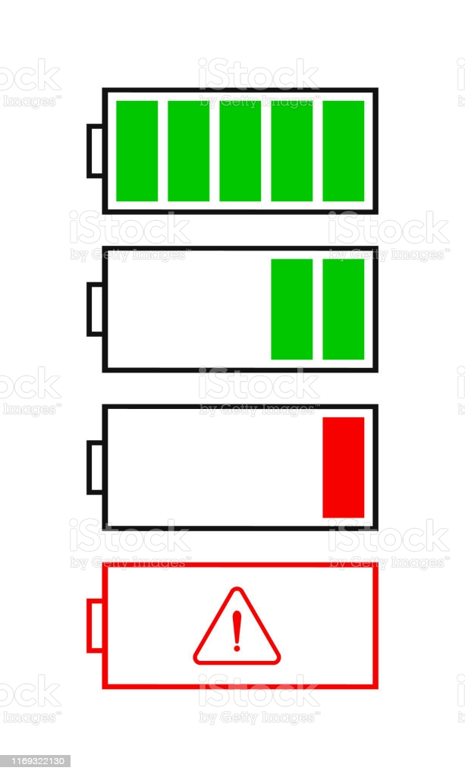
Know your limit! daily assessment
Tiredness level
Dizzy? Unsteady?
Depressed? Difficulty w/ concentration?
If I am not feeling well, can I postpone the tasks on my to-do list?
Should I modify my plan of attack?
Ask a friend/family member to tagalong
Bring assistive device
Limit distractions (ex: go to grocery stores earlier to avoid the crowds)

Slide 19
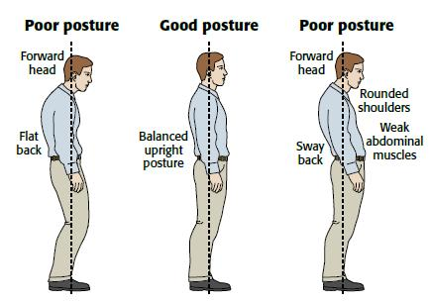
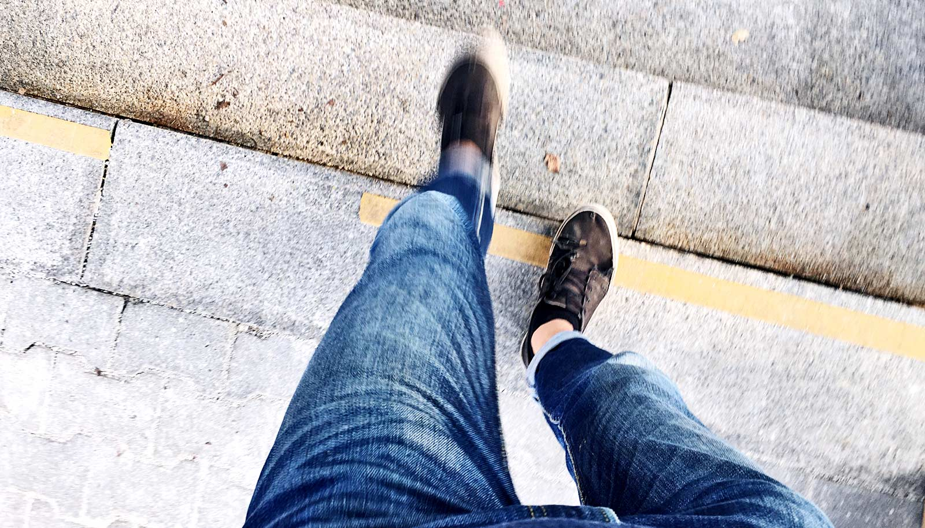
When walking:
POSTURE!
Look what is up ahead
No, this does not mean staring at your feet while walking
Pay attention to foot clearance
Am I dragging my foot? I might trip over things.
Proper placement of assistive devices
Distance of walker or cane from your body
Limit distractions
Internal: thinking of other things, planning things in head
External: cellphone, carrying heavy items

Slide 20
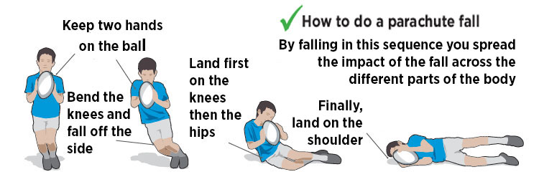
How to fall safely
Stay bent
Do not be rigid; get ready to fall on knees and elbows
Protect your head
Falling forward: turn face to the side
Falling backward: tuck your chin in
Land on meaty area
Buttocks, back, thigh
Keep falling
Keep rolling – spread the impact to larger part of your body
Notes:
https://www.aarp.org/health/conditions-treatments/info-2017/how-to-fall-safely.html

Slide 21
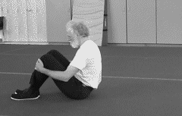
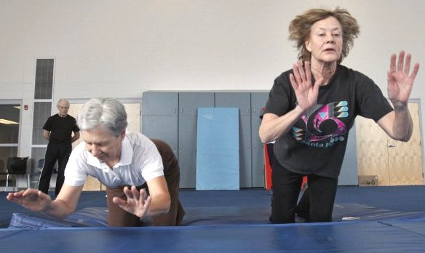
Exercises to practice falling
Falling backward
Sit on floor or bed w/ chin tucked in, knees bent, arms around knee or tucked in front of chest
Rock your body backward to lay down with knees still bent
Falling sideway
Same motion as backward but twist your body to lay on your side
Falling forward
Start in kneeling position w/ back of hands in front of your face
Rock your body forward to land on forearms and hand
Notes:
http://www.fearlessfalling.com/FFClassNotes.html

Slide 22
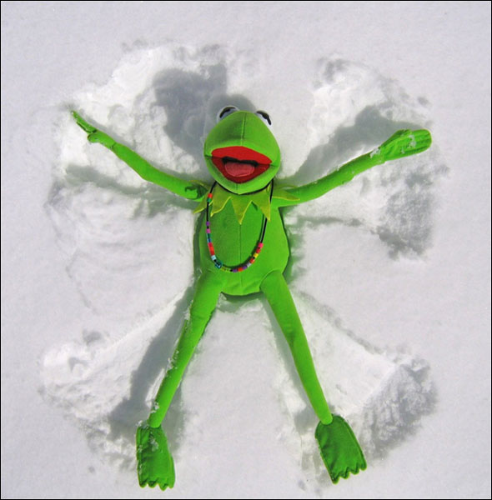
Considerations when on the ground
DO NOT MOVE
Unconscious, dizziness, nausea, bleeding from head or ear
Decreased sensation or movement in any limb,
Extreme pain

Slide 23
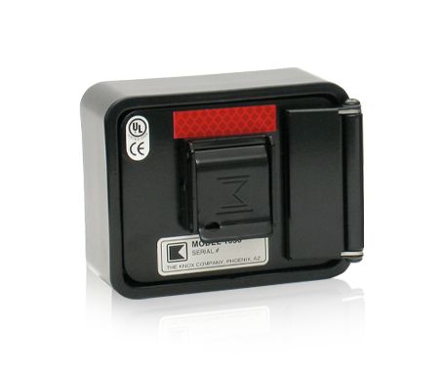
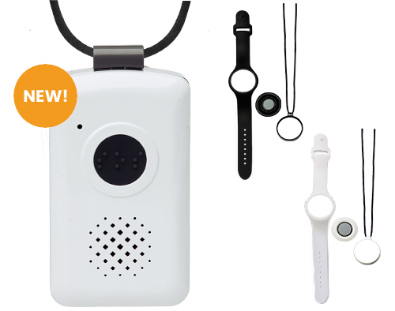
Get Help
Carry phone with you
Watches that link to your phone
Medical Alert System
Example: life alert, lifeline, Medical Guardian
Knox Box
Allow direct access by Fire Dept to enter home without breaking properties
Check with local Fire Dept or knoxbox.com
Have a copy of your insurance card, ID, medication list, emergency contact at the door or on your phone for easy access
Notes:
Residental knox box, approved by Pasadena Fire Dept $283.00

Slide 24
Notes:
https://www.lifeline.philips.com/content/dam/PLL/PLL-B2C/PDFs/How-to-Get-Up-From-a-Fall.pdf

Slide 25
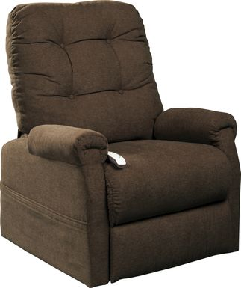
Special considerations
Object/furniture for stability
Good example: chair against wall
Stay away from: doorknobs, towel racks, oven door handles, rocking chair, chairs with wheels
Increase foot friction
To get off the floor without sliding
Good example: barefooted, shoes, slippers w/ rubber soles

Slide 26
Useful Resources
Your doctors
ME! (Outpatient P.T. for balance and strength assessment)
Home P.T. for home safety evaluation
Online websites on information on fall
National Institute on Aging
CDC – STEADI (stop elderly accidents, deaths, & injuries)
National Council on Aging
Community
Be a SilverSneakers member to gain free/cheap access to fitness club
Local senior center for classes and lectures on balance or fitness
Yourself! Tag a friend and start a walking program together

Slide 28
References
10 Environmental Hazards That Cause Older Adults To Fall & How to Avoid Them. Health Care Associates. https://healthcareassociates.net/top-10-tripping-hazards-for-older-adults/ Accessed September 23, 2018.
Balance Exercises for Seniors. https://www.ptprogress.com/balance-exercises-for-seniors/. Accessed September 22, 2021.
Fall-Proofing your Home. National Institute on Aging. https://www.nia.nih.gov/health/fall-proofing-your-home Updated May 15, 2017. Accessed September 23, 2018.
How to Fall Safely. https://www.aarp.org/health/conditions-treatments/info-2017/how-to-fall-safely.html. Accessed September 22, 2021
How to Get Up from A Fall. https://www.lifeline.philips.com/content/dam/PLL/PLL-B2C/PDFs/How-to-Get-Up-From-a-Fall.pdf. Assessed on September 22, 2021.
Important Facts about Falls. Centers for Disease Control and Prevention. https://www.cdc.gov/homeandrecreationalsafety/falls/adultfalls.html Updated February 10, 2017. Accessed September 23, 2018.
Low Blood Sugar. Healthline. https://www.healthline.com/health/hypoglycemia#symptoms Accessed September 23, 2018.
Minor, MA, Minor S. Ambulation with Ambulatory Assistive Devices. In: Minor, MA, Minor S, eds. Patient Care Skills. 6th ed. Upper Saddle River, NJ: Pearson; 2010
Safe Falling Class Format and General Information. http://www.fearlessfalling.com/FFClassNotes.html. Accessed on September 22, 2021.

Slide 29
Fall prevention and recovery
W. Julia Masulis, PT, DPT, NCS
Email me if you have any questions: Wingsheung.masulis@huntingtonhospital.com

